Slide 1




Slide 2


Slide 3
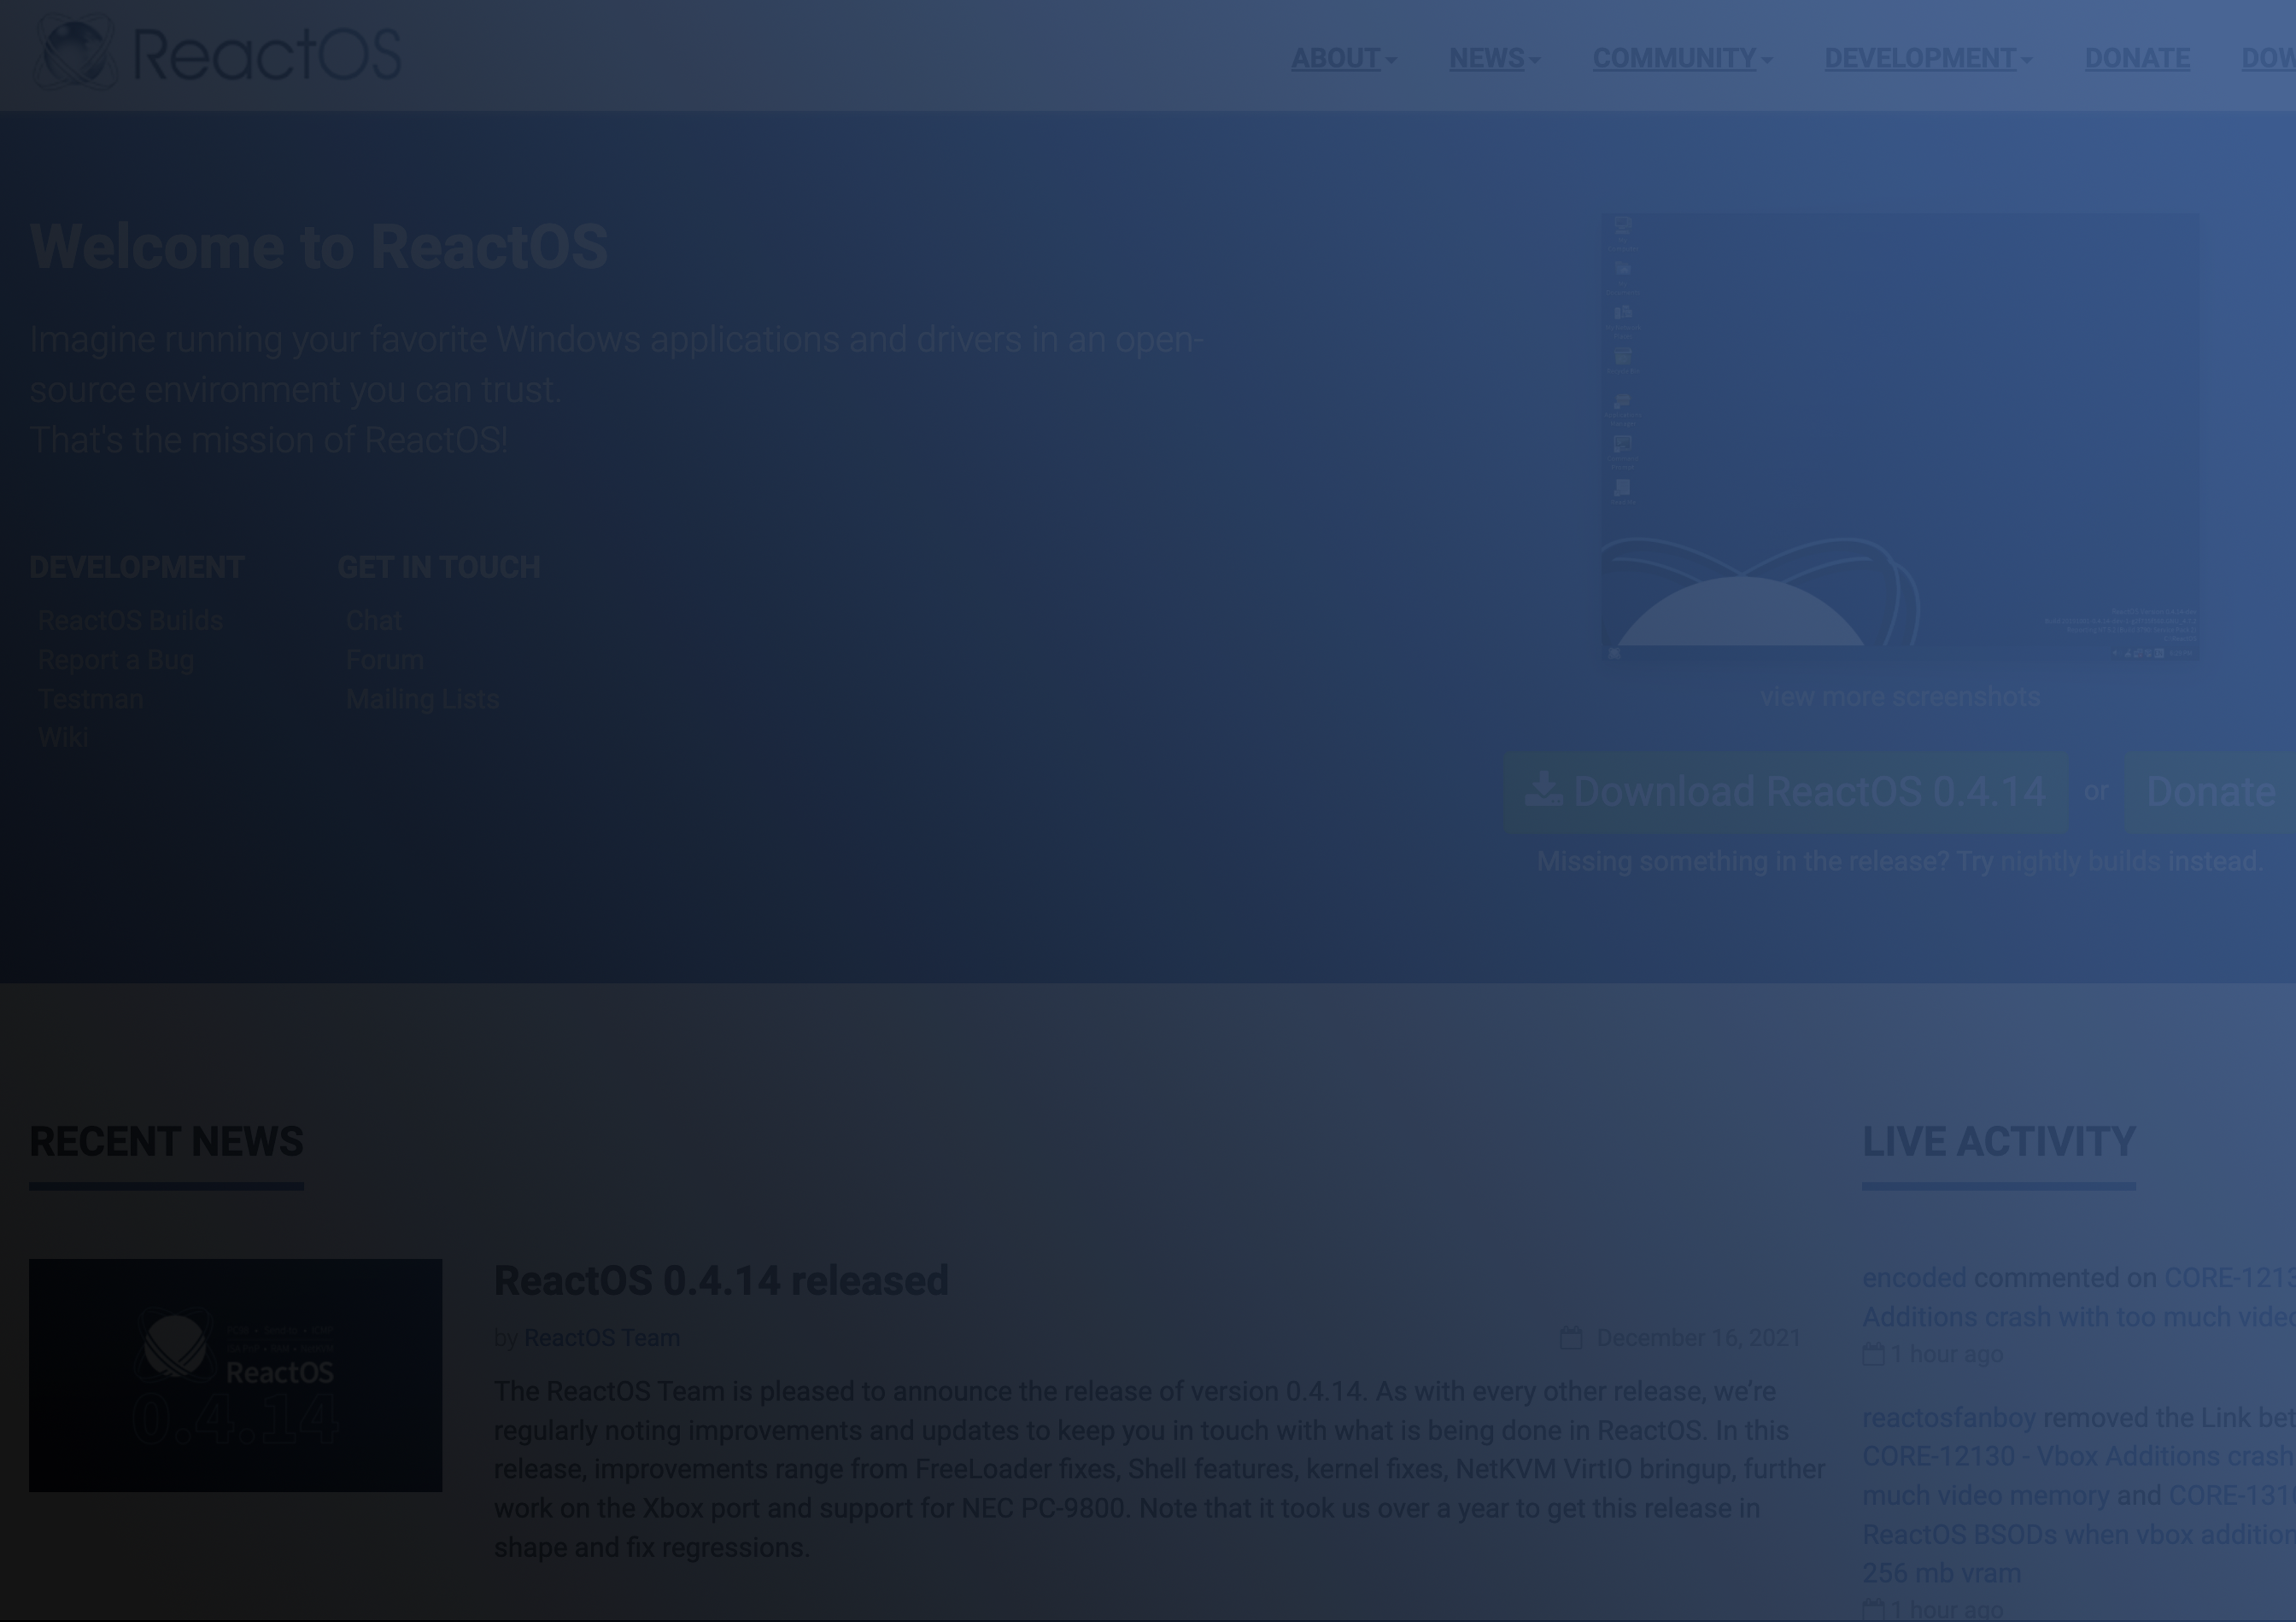

Welcome To
Presentation
ReactOS:
What is it?
What can it do?
What’s in the Works?
ReactOS, the opensource Windows™ clone.

Slide 4
What
Is
It?
Run Windows software
Run Windows drivers
Just download the software, click, Install, click, Works (*cough* it should but…)
Just download the driver, click, install, click, Works (*cough* it should…)
A cloning effort in an opensource environment.
Really nice progress with “real” hardware drivers

Slide 5
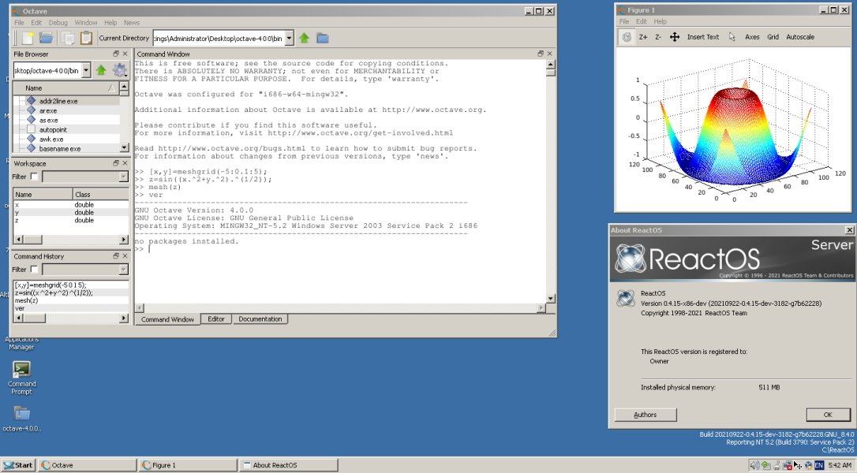
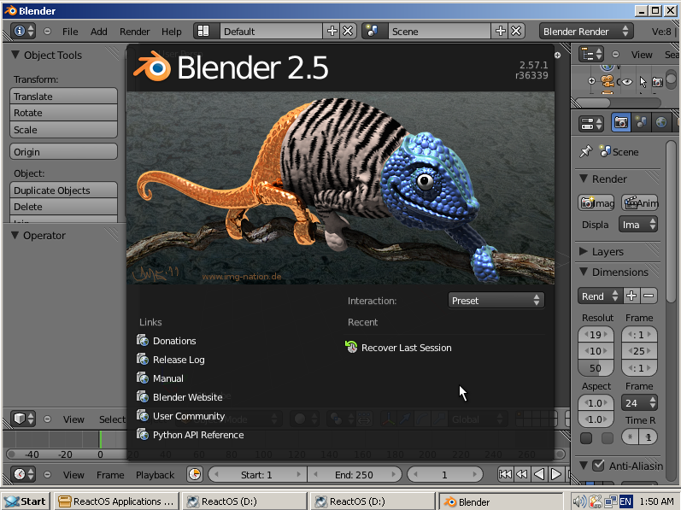
Windows
Software
Using opensource (or whateversource) created for Windows but in an opensource environment is our objective.
Let’s not be tied to a closed operating system.

Slide 6
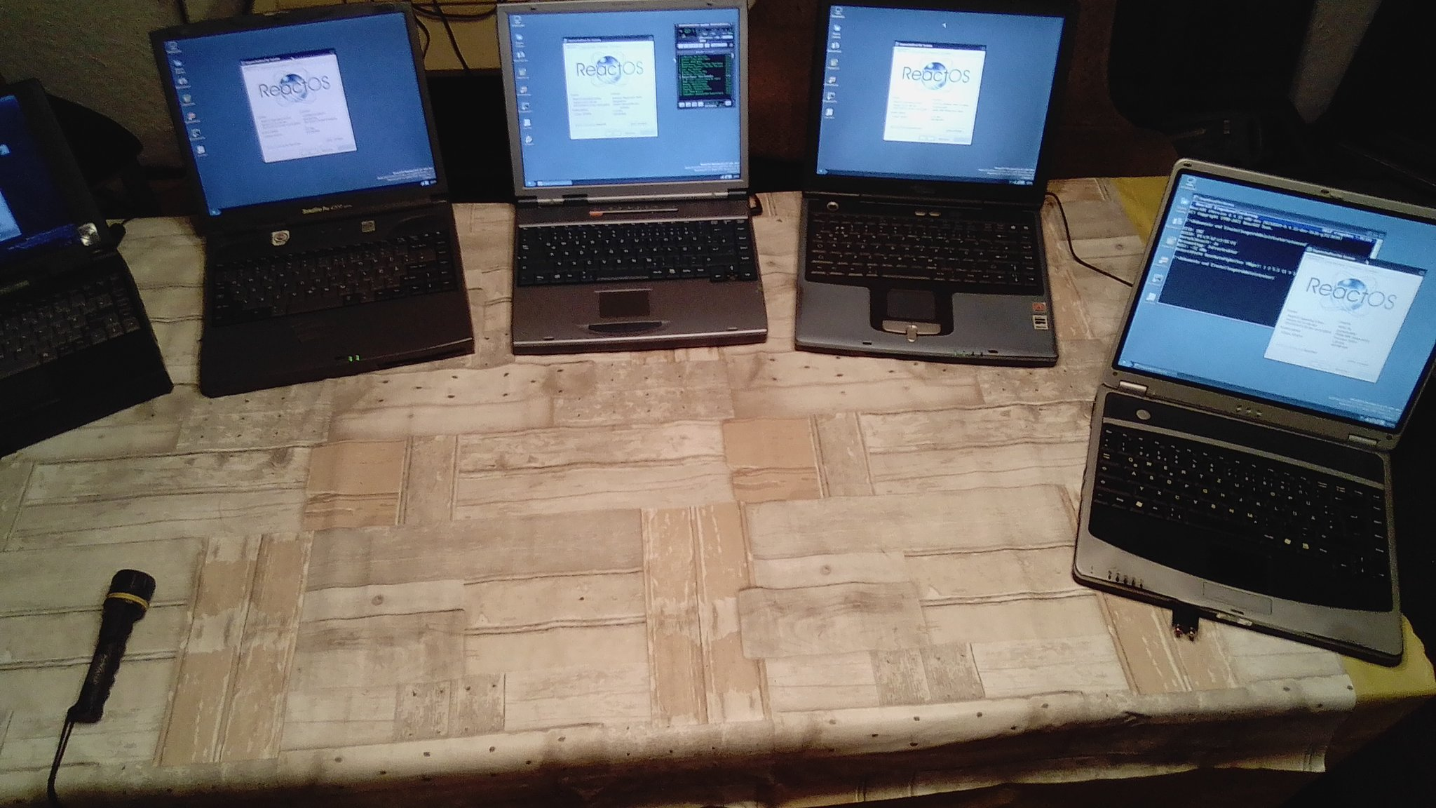
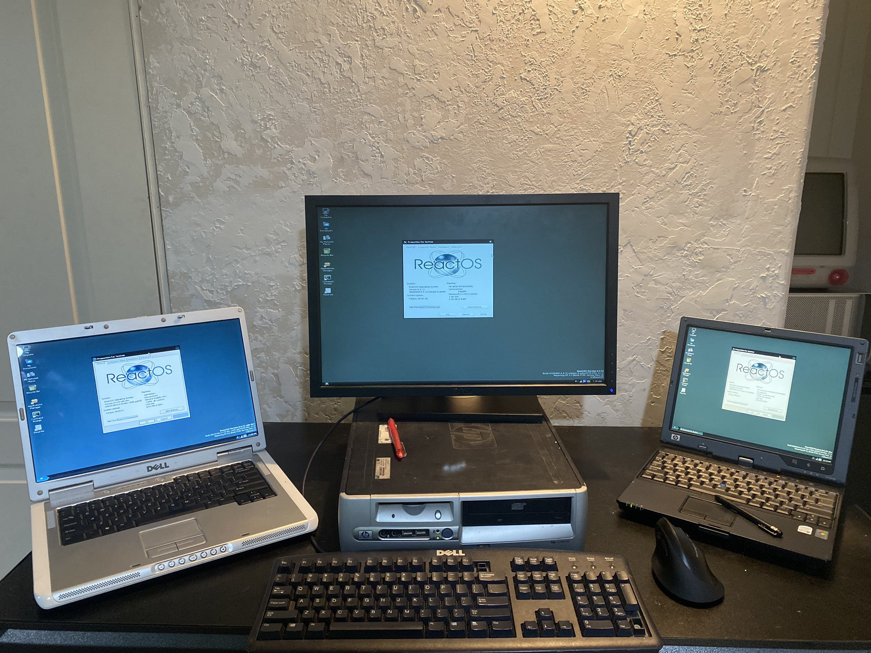
Windows
Drivers
Using opensource (or whateversource) created for Windows but in an opensource environment is our objective.
Let’s not be tied to a closed operating system.

Slide 7
What
Is
It?
Opensource project
Amazing Community
Full opensource, with its repos living in GitHub..
Twitter, Matrix, Discord…
ReactOS has been around for more than 20 years now.
Keeps growing!!

Slide 8
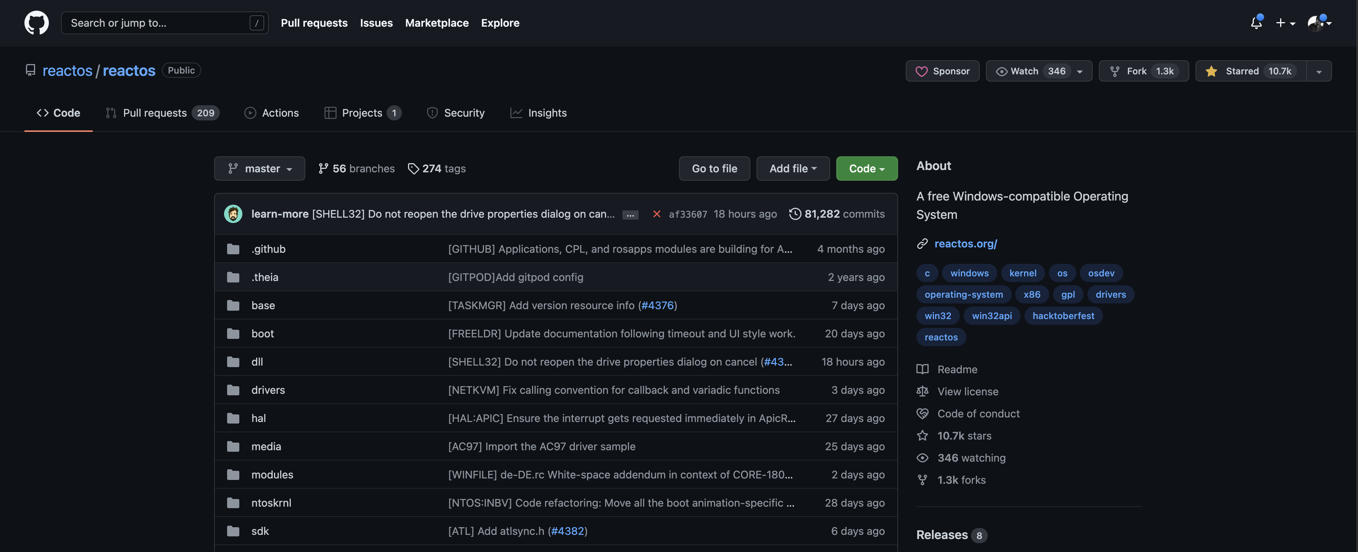
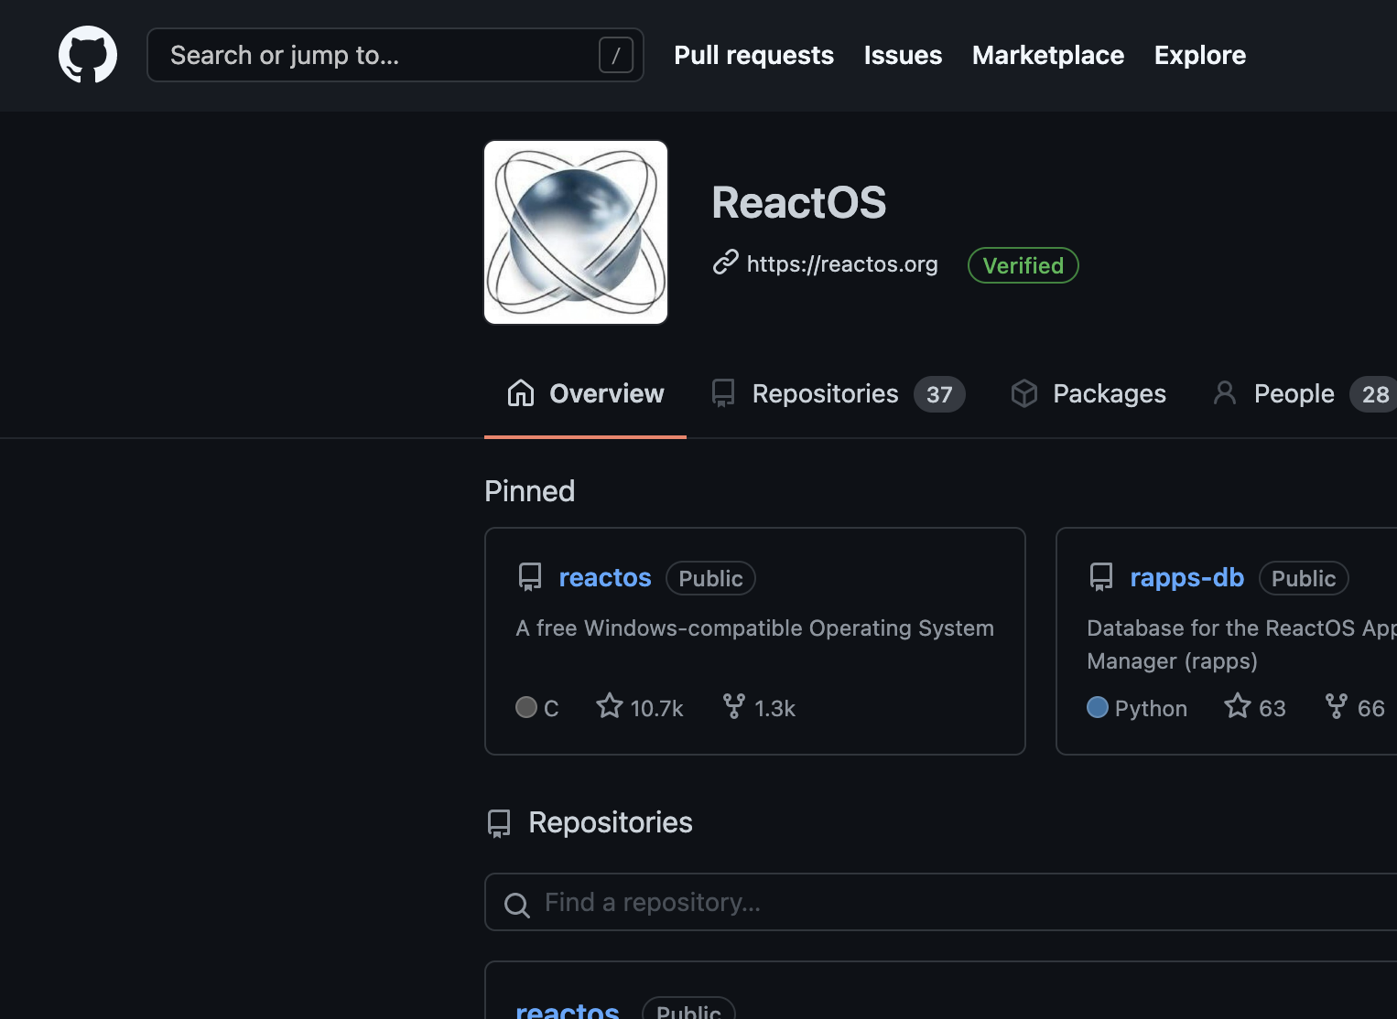
OpenSource
Project
1,300 times Forked.
10,700 times Liked.
No Gov support.
No Companies support.
Fully Community driven.

Slide 9
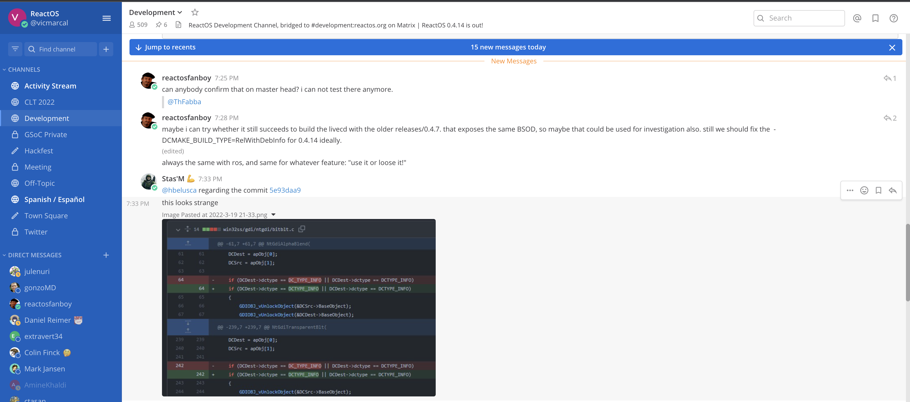
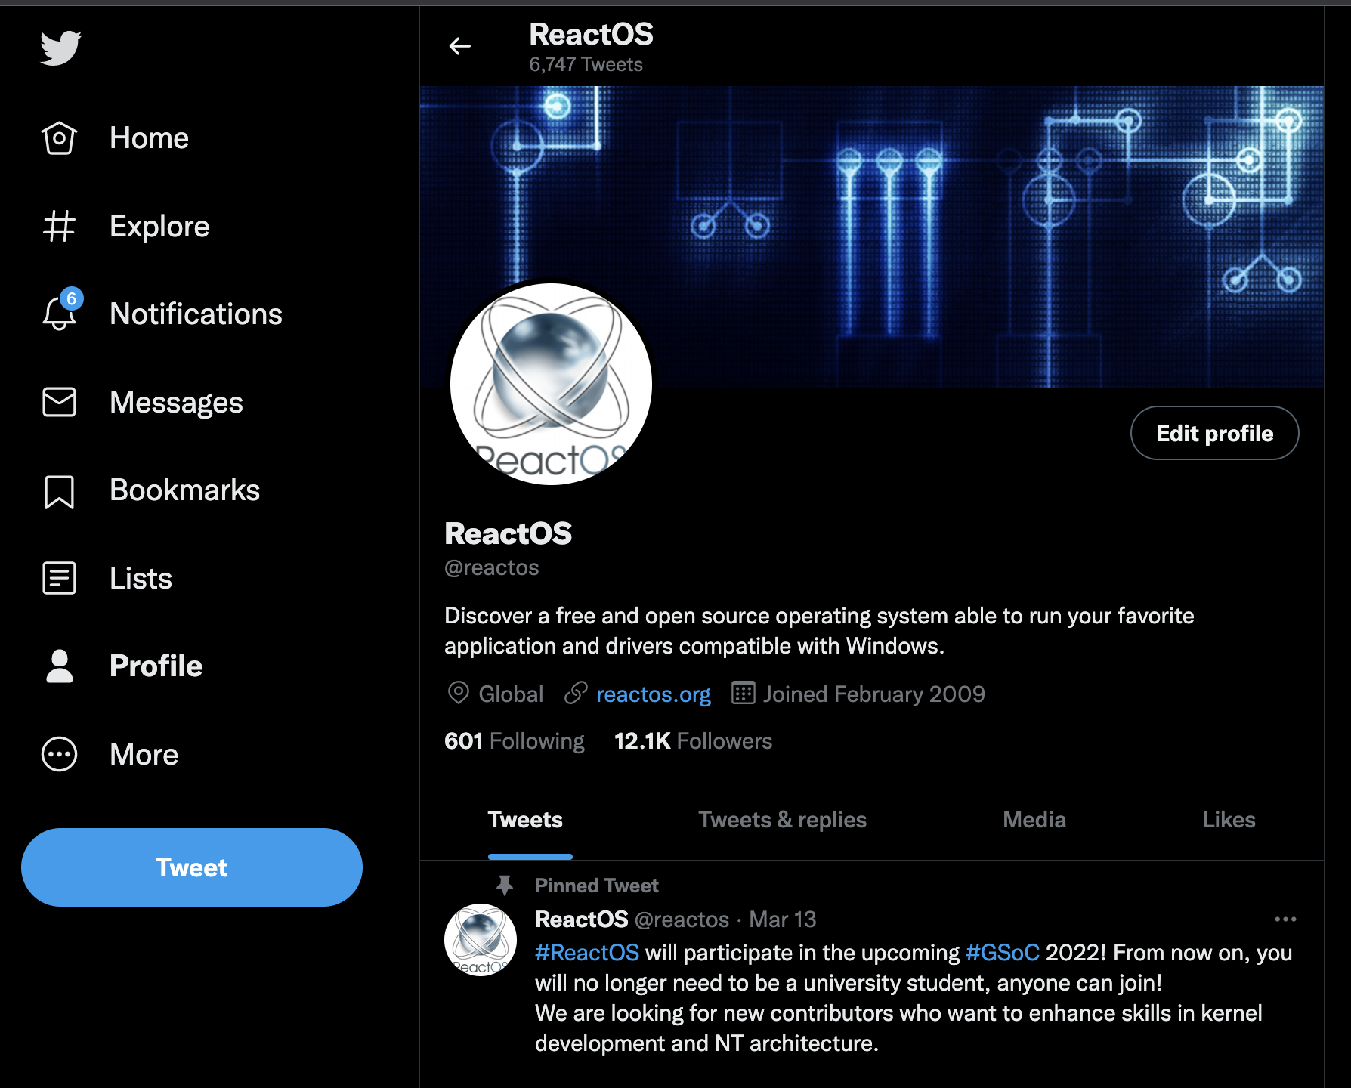

Amazing
Community
ReactOS: @reactos
ReactOS German: @reactosgerman
ReactOS Spanish: @reactos-es
ReactOS Turkish: @reactos_tr
ReactOS Japan: @reactosjpn
ReactOS Italia: @reactositalia
ReactOS Philipines: @reactosph
Chat.reactos.org (Mattermost)
ReactOS (Discord)

Slide 10
What
Is
It?
Massively Tested
Real Reference
More than 14 Million tests are covering our code.
WinAPI, NT Kernel: from real usage to undocumented bits and bytes.
One of the largest test suites out there.
Drivers and SW implementation reference.

Slide 11
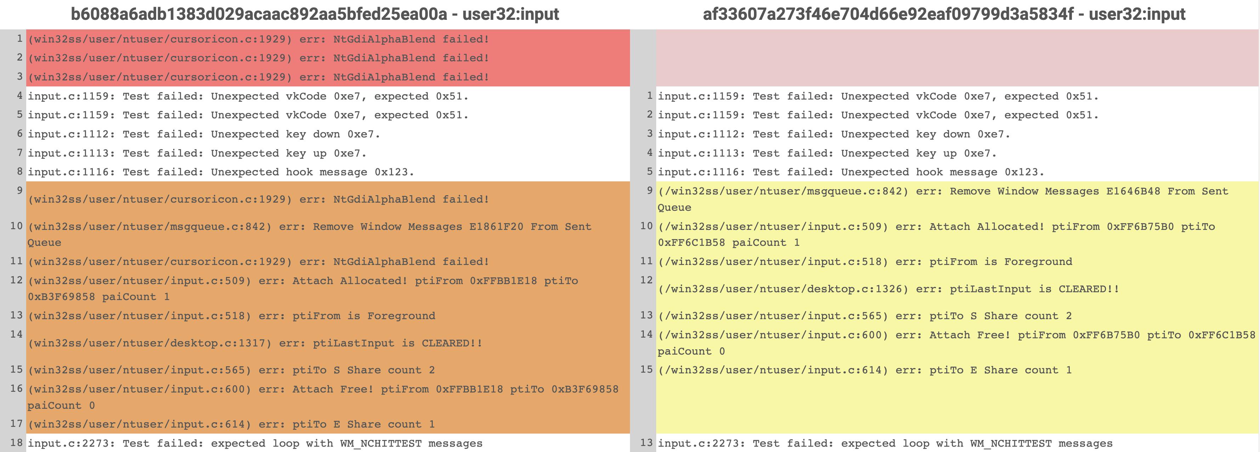
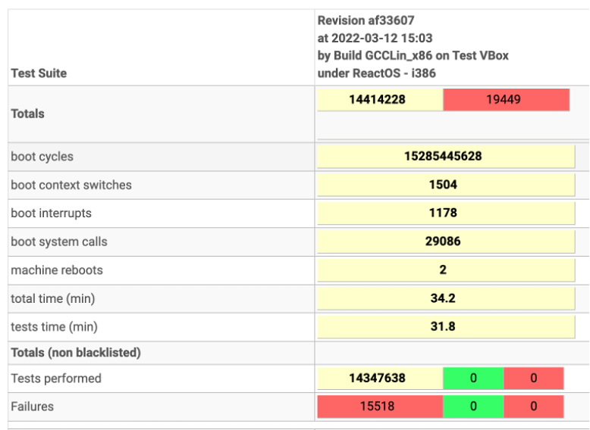
Massively
Tested
Understanding how Windows works.
Testing against ReactOS.
Fix and Repeat.
Avoiding Regressions. Avoiding legal issues:
https://reactos.org/testman/

Slide 12
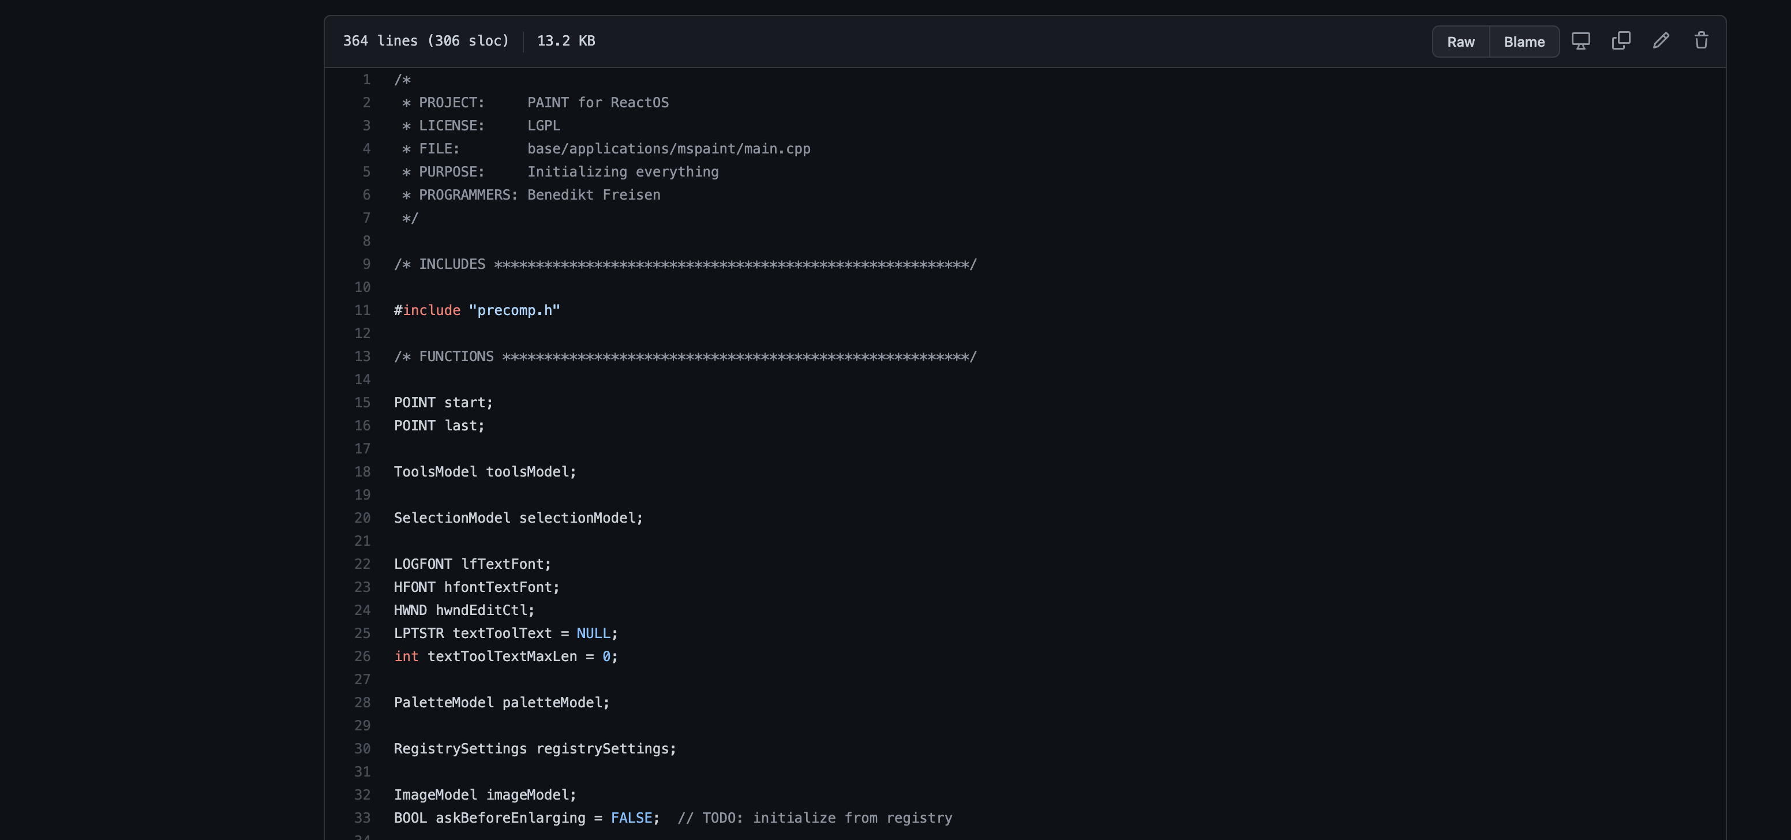
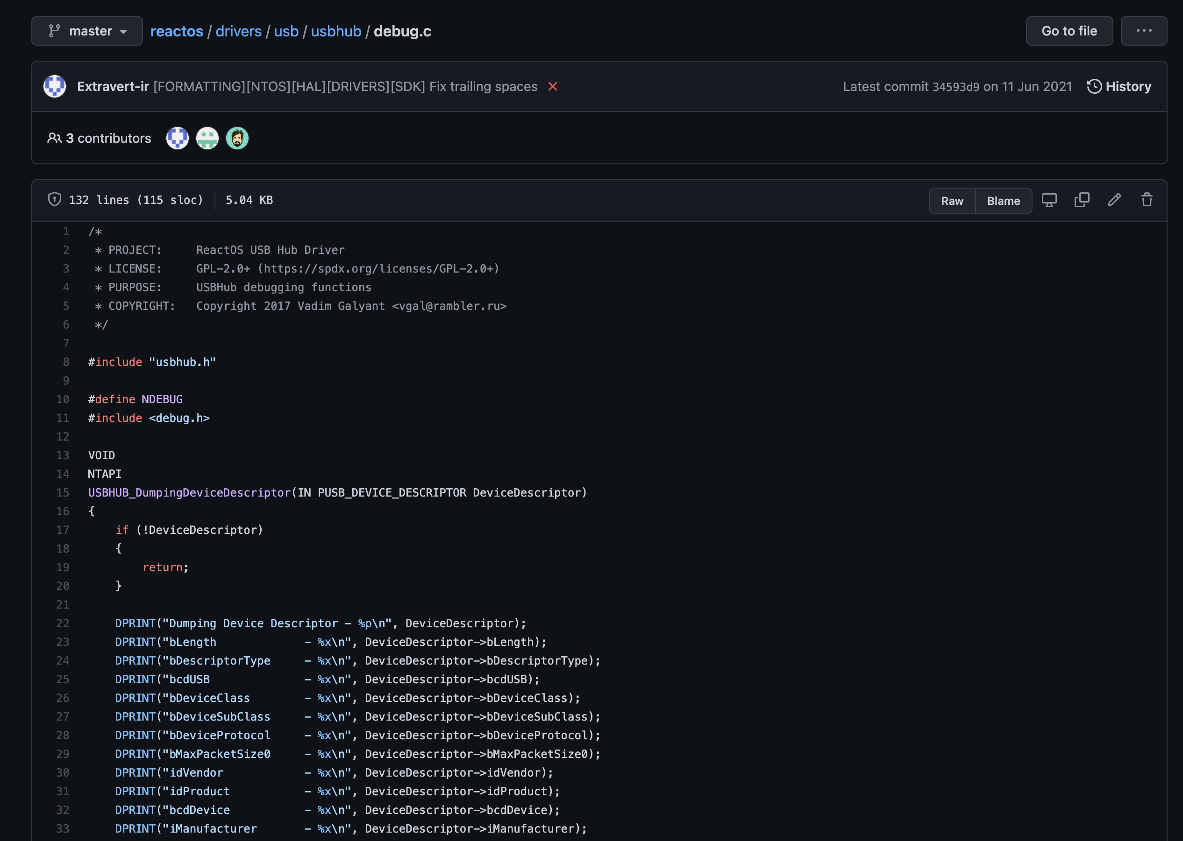
Real
Reference
Opensource Drivers: USB, Filters, Btrfs, ….
Opensource Software: Paint, Calc, Notepad, Magnify….
A real reference for OS Developers

Slide 13
What
Is
It?
Ugly and Beautiful
Alpha
Themes are available to make it as Ugly or Beautiful as you wish.
Slowly but steady
MsStyles ;)
Any help is welcome ☺

Slide 14
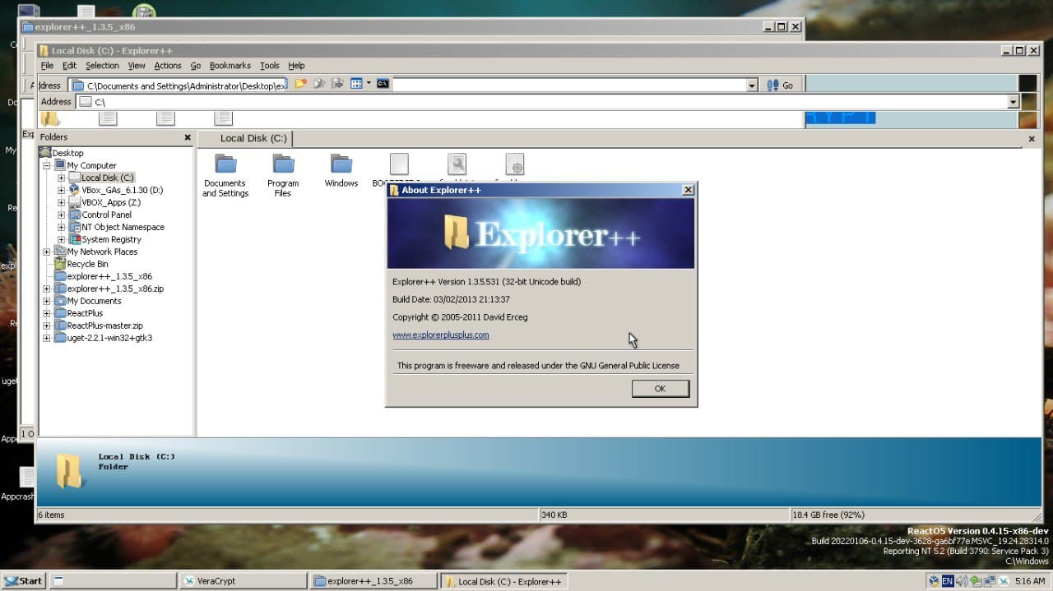
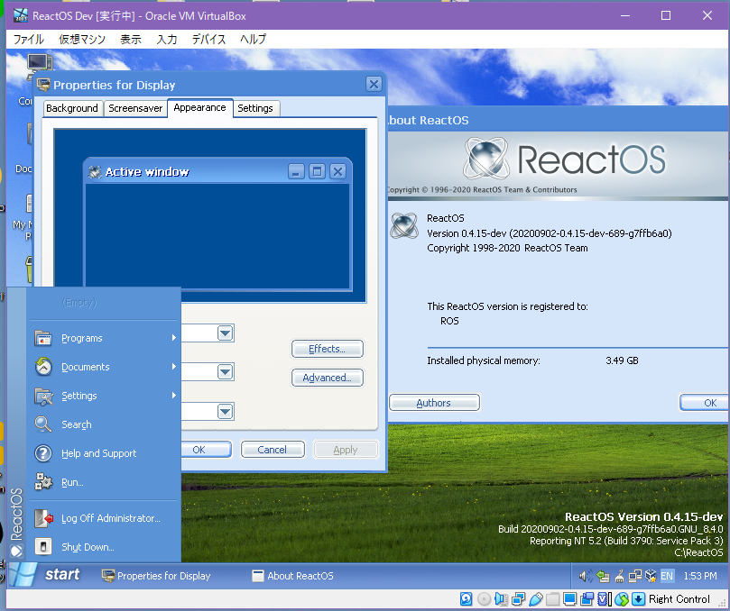
Ugly and
Beautiful
ReactOS supports MsStyles.
Classic or not-Classic: That is the question.

Slide 15
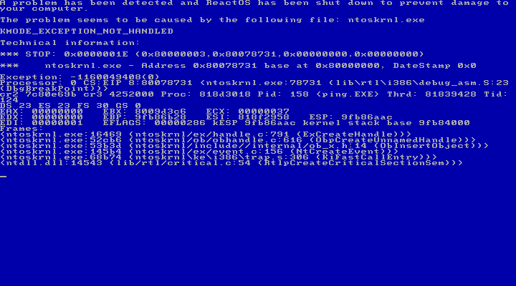
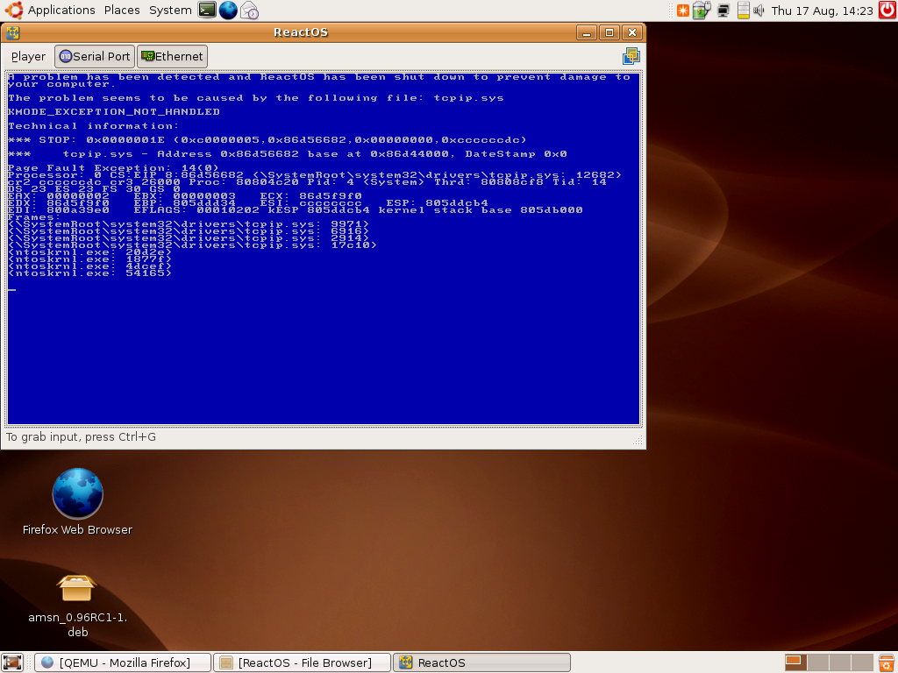
Alpha
Still ”some” work to be done…
Time to move into the “What is being done” part!
Yes. It will crash and kill several dozens of Kittens.
Please be aware!!

